Slide 1
Module -IV
Java Programming
TCS 408

Slide 2
Two Event Handling Mechanisms
The way in which events are handled changed significantly between the original version of Java (1.0) and all subsequent versions of Java, beginning with version 1.1.
Although the 1.0 method of event handling is still supported, it is not recommended for new programs.
Also, many of the methods that support the old 1.0 event model have been deprecated.
The modern approach is the way that events should be handled by all new programs.

Slide 3
The Delegation Event Model
The modern approach to handling events is based on the delegation event model, which defines standard and consistent mechanisms to generate and process events.
Its concept is quite simple: a source generates an event and sends it to one or more listeners.
In this scheme, the listener simply waits until it receives an event. Once an event is received, the listener processes the event and then returns.
The advantage of this design is that the application logic that processes events is cleanly separated from the user interface logic that generates those events.
A user interface element is able to “delegate” the processing of an event to a separate piece of code.

Slide 4
In the delegation event model, listeners must register with a source in order to receive an event notification.
This provides an important benefit: notifications are sent only to listeners that want to receive them.
This is a more efficient way to handle events than the design used by the original Java 1.0 approach.
Previously, an event was propagated up the containment hierarchy until it was handled by a component.
This required components to receive events that they did not process, and it wasted valuable time. The delegation event model eliminates this overhead.

Slide 5
Events
In the delegation model, an event is an object that describes a state change in a source.
Among other causes, an event can be generated as a consequence of a person interacting with the elements in a graphical user interface.
Some of the activities that cause events to be generated are pressing a button, entering a character via the keyboard, selecting an item in a list, and clicking the mouse.
Many other user operations could also be cited as examples. Events may also occur that are not directly caused by interactions with a user interface.
For example, an event may be generated when a timer expires, a counter exceeds a value, software or hardware failure occurs, or an operation is completed. You are free to define events that are appropriate for your application.

Slide 6
Event Sources
A source is an object that generates an event. This occurs when the internal state of that object changes in some way.
Sources may generate more than one type of event. A source must register listeners in order for the listeners to receive notifications about a specific type of event.
Each type of event has its own registration method.
Here is the general form:
public void addTypeListener (TypeListener el )
Here, Type is the name of the event, and el is a reference to the event listener.
For example, the method that registers a keyboard event listener is called addKeyListener( ). The method that registers a mouse motion listener is called addMouseMotionListener( ).

Slide 7
When an event occurs, all registered listeners are notified and receive a copy of the event object.
This is known as multicasting the event. In all cases, notifications are sent only to listeners that register to receive them.
Some sources may allow only one listener to register. The general form of such a method is this:
public void addTypeListener(TypeListener el )
java.util.TooManyListenersException
Here, Type is the name of the event, and el is a reference to the event listener. When such an event occurs, the registered listener is notified. This is known as unicasting the event.

Slide 8
A source must also provide a method that allows a listener to unregister an interest in a specific type of event. The general form of such a method is this:
public void removeTypeListener(TypeListener el )
For example, to remove a keyboard listener, you would call removeKeyListener( ).
The methods that add or remove listeners are provided by the source that generates events.
For example, the Component class provides methods to add and remove keyboard and mouse event listeners.

Slide 9
Event Listeners
A listener is an object that is notified when an event occurs. It has two major requirements.
First, it must have been registered with one or more sources to receive notifications about specific types of events.
Second, it must implement methods to receive and process these notifications.
The methods that receive and process events are defined in a set of interfaces, such as those found in java.awt.event.
For example, the MouseMotionListener interface defines two methods to receive notifications when the mouse is dragged or moved.
Any object may receive and process one or both of these events if it provides an implementation of this interface.

Slide 10
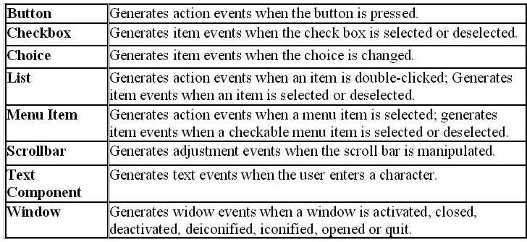
Sources Generating Events

Slide 11
Important Event Classes
and Interface
Event Classes | Description | Listener Interface
ActionEvent | generated when button is pressed, menu-item is selected, list-item is double clicked | ActionListener
MouseEvent | generated when mouse is dragged, moved, clicked, pressed or released and also when it enters or exit a component | MouseListener
KeyEvent | generated when input is received from keyboard | KeyListener
ItemEvent | generated when check-box or list item is clicked | ItemListener
TextEvent | generated when value of textarea or textfield is changed | TextListener
MouseWheelEvent | generated when mouse wheel is moved | MouseWheelListener
WindowEvent | generated when window is activated, deactivated, deiconified, iconified, opened or closed | WindowListener
ComponentEvent | generated when component is hidden, moved, resized or set visible | ComponentEventListener
ContainerEvent | generated when component is added or removed from container | ContainerListener
AdjustmentEvent | generated when scroll bar is manipulated | AdjustmentListener
FocusEvent | generated when component gains or loses keyboard focus | FocusListener

Slide 12
Events Handling steps
Two Steps to handle events:
Implement appropriate interface in the class.
Register the component with the listener.

Slide 13
Registration Methods
For registering the component with the Listener, many classes provide the registration methods.
For example:
Button
public void addActionListener(ActionListener a){}
MenuItem
public void addActionListener(ActionListener a){}
TextField
public void addActionListener(ActionListener a){}
public void addTextListener(TextListener a){}
TextArea
public void addTextListener(TextListener a){}
Checkbox
public void addItemListener(ItemListener a){}
Choice
public void addItemListener(ItemListener a){}
List
public void addActionListener(ActionListener a){}
public void addItemListener(ItemListener a){}

Slide 14
ActionEvent
An ActionEvent is generated when a button is pressed, a list item is double-clicked, or a menu item is selected.
The ActionEvent class defines four integer constants that can be used to identify any modifiers associated with an action event:
public static final int ALT_MASK
The alt modifier. An indicator that the alt key was held down during the event. (8)
public static final int SHIFT_MASK
The shift modifier. An indicator that the shift key was held down during the event. (1)
public static final int CTRL_MASK
The control modifier. An indicator that the control key was held down during the event. (2)
public static final int META_MASK

Slide 15
Syntax Example
PublicActionEvent(Object source, int id, String command, int modifiers)
Constructs an ActionEvent object with modifier keys.
Parameters: source - the object that originated the event
id - an integer that identifies the event
command - a string that may specify a command (possibly one of several) associated with the event
modifiers - the modifier keys held down during this action
Example:
public ActionEvent(Object source, int id, String command, long when, int modifiers)
Constructs an ActionEvent object with the specified modifier keys and timestamp.
Parameters:
source - the object that originated the event.
id - an integer that identifies the event.
command - a string that may specify a command (possibly one of several) associated with the event.
when - the time the event occurred.
modifiers - the modifier keys held down during this action.

Slide 16
Methods
public String getActionCommand()
Returns the command string associated with this action.
public long getWhen()
Returns the timestamp of when this event occurred.
int getModifiers()
Returns the modifier keys held down during this action event.
String paramString()
Returns a parameter string identifying this action event.

Slide 17
ActionListener Interface
This interface defines the actionPerformed() method that is invoked when an action event occurs.
Its general form is shown here:
void actionPerformed(ActionEvent ae)

Slide 18
import java.awt.*;
import java.awt.event.*;
public class Main extends WindowAdapter implements ActionListener //for button action event
{
Frame f;
TextField tf;
Button b;
Main()
{
f=new Frame();
f.setLayout(new FlowLayout());
f.setSize(300,300);
f.setVisible(true);
b= new Button("Click Me");
tf=new TextField(10);
f.add(b);
f.add(tf);
b.addActionListener(this);
f.addWindowListener (this);
}
public void windowClosing (WindowEvent e) {
f.dispose();
}
public void actionPerformed(ActionEvent ae)
{
String str = ae.getActionCommand();
tf.setText(str);}
public static void main(String args[])
{
Main obj=new Main();
}
}

Slide 19
import java.awt.*;
import java.awt.event.*;
public class Login extends Frame implements ActionListener
{
TextField nameField, passField, resultField;
Label lab1, lab2;
Button b;
public Login()
{ // set layout
setLayout(new GridLayout(3, 2, 0, 10)); //rows,column, hgap,vgap
setBackground(Color.pink); // fill the gap with color
// create components
nameField = new TextField(15);
passField = new TextField(15);
resultField = new TextField(15);
lab1 = new Label("Enter User Name");
lab2 = new Label("Enter Password");
//lab3 = new Label("Display Result");
b=new Button("Enter");
// register the listener
b.addActionListener(this);
// beautification
passField.setEchoChar('*');
resultField.setEditable(false);
add(lab1); add(nameField);
add(lab2); add(passField);
add(b);
add(resultField);
setTitle("User Name & Password Validation");
setSize(300, 300);
setVisible(true);
}

Slide 20
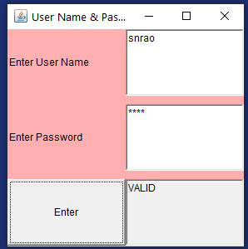
public void actionPerformed(ActionEvent e)
{ // get the values entered by the user
String str1 = nameField.getText();
String str2 = passField.getText();
// some validation code
if(str1.equals("snrao") && str2.equals("java"))
{
resultField.setText("VALID");
}
else
{
resultField.setText("INVALID, TRY AGAIN");
}
}
public static void main(String args[])
{
Login obj=new Login();
}
}

Slide 21
ComponentEvent class
A low-level event which indicates that a component moved, changed size, or changed visibility.
This class has following constants.
public static final int COMPONENT_MOVED
This event indicates that the component's position changed.
public static final int COMPONENT_RESIZED
This event indicates that the component's size changed.
public static final int COMPONENT_SHOWN
This event indicates that the component was made visible.
public static final int COMPONENT_HIDDEN
This event indicates that the component was become invisible.

Slide 22
Conti…
public ComponentEvent(Component source, int id)
Constructs a ComponentEvent object.
Parameters:
source - the Component that originated the event
id - an integer indicating the type of event
Component getComponent()
Returns the creator of the event.
the Component object that originated the event, or null if the object is not a Component.

Slide 23
ComponentListener interface
The listener interface for receiving component events.
void componentResized(ComponentEvent e)
Invoked when the component's size changes.
void componentMoved(ComponentEvent e)
Invoked when the component's position changes
void componentShown(ComponentEvent e)
Invoked when the component has been made visible.
void componentHidden(ComponentEvent e)
Invoked when the component has been made invisible.

Slide 24
Container
Container classes are classes that can have other components on it. There are 3 types of Java Swing containers.
Panel: It is a pure container and is not a window in itself. The sole purpose of a Panel is to organize the components on to a window.
Frame: It is a fully functioning window with its title and icons.
Dialog: It is like a pop-up window that pops out when a message has to be displayed. It is not a fully functioning window like the Frame.

Slide 25
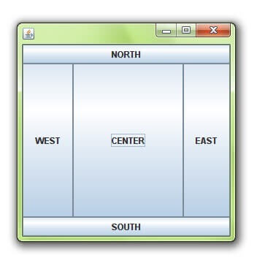
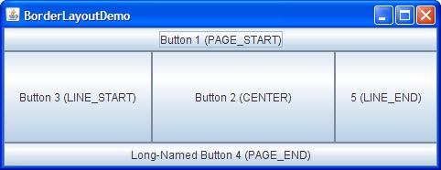
Java Layout Manager
The Layout manager is used to arrange the GUI java components inside a container.
Java BorderLayout
A BorderLayout places components in up to five areas: top, bottom, left, right, and center. It is the default layout manager for every java Jframe.

Slide 26

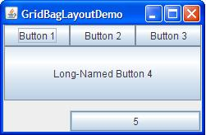
Java FlowLayout
FlowLayout is the default layout manager for every JPanel. It simply lays out components in a single row one after the other.
Java GridBagLayout
It is the more sophisticated of all layouts. It aligns components by placing them within a grid of cells, allowing components to span more than one cell.

Slide 27
Java Swing
Java Swing is a part of Java Foundation Classes (JFC) that is used to create window-based applications. It is built on the top of AWT (Abstract Windowing Toolkit) API and entirely written in java.
Java Foundation Classes (JFC) are a set of GUI components which simplify the development of desktop applications.
Java Swing provides platform-independent and lightweight components.
The javax.swing package provides classes for java swing API such as JButton, JTextField, JTextArea, JRadioButton, JCheckbox, JMenu, JColorChooser etc.

Slide 28
S.NO | AWT | Swing
1. | Java AWT is an API to develop GUI applications in Java | Swing is a part of Java Foundation Classes and is used to create various applications.
2. | The components of Java AWT are heavy weighted. | The components of Java Swing are light weighted.
3. | Java AWT has comparatively less functionality as compared to Swing. | Java Swing has more functionality as compared to AWT.
4. | The execution time of AWT is more than Swing. | The execution time of Swing is less than AWT.
5. | The components of Java AWT are platform dependent. | The components of Java Swing are platform independent.
6. | Model-View-Controller (MVC) for web devemopment pattern is not supported by AWT. | MVC pattern is supported by Swing.
7. | AWT provides comparatively less powerful components. | Swing provides more powerful components.

Slide 29
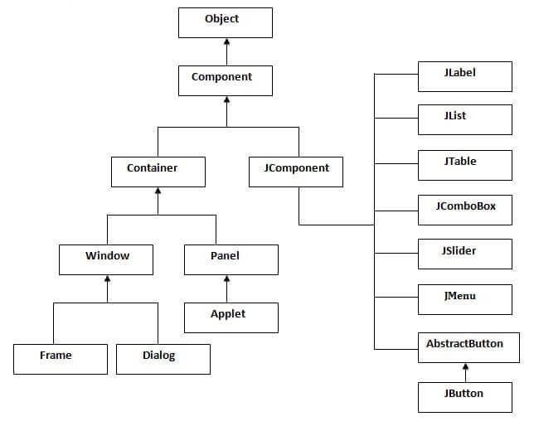
Java Swing Classes

Slide 30
import javax.swing.*;
import java.awt.*;
class gui {
public static void main(String args[])
{
//Creating the Frame
JFrame frame = new JFrame("Chat Frame"); frame.setDefaultCloseOperation(JFrame.EXIT_ON_CLOSE);
frame.setSize(400, 400);
//Creating the MenuBar and adding components
JMenuBar mb = new JMenuBar();
JMenu m1 = new JMenu("FILE");
JMenu m2 = new JMenu("Help");
mb.add(m1);
mb.add(m2);
JMenuItem m11 = new JMenuItem("Open");
JMenuItem m22 = new JMenuItem("Save as");
m1.add(m11);
m1.add(m22);
//Creating the panel at bottom and adding components
JPanel panel = new JPanel();
JLabel label = new JLabel("Enter Text");
JTextField tf = new JTextField(10);

Slide 31
JButton send = new JButton("Send");
JButton reset = new JButton("Reset");
panel.add(label); // Components Added using Flow Layout
panel.add(tf);
panel.add(send);
panel.add(reset);
JTextArea ta = new JTextArea();
//Adding Components to the frame.
frame.getContentPane().add(BorderLayout.SOUTH, panel);
frame.getContentPane().add(BorderLayout.NORTH, mb);
frame.getContentPane().add(BorderLayout.CENTER, ta);
frame.setVisible(true);
} }

Slide 32
WAP to change the background color of a Fame by clicking on Button.
import java.awt.*;
import java.awt.event.*;
public class Main extends Frame implements ActionListener //for button action event
{
Button b1,b2,b3;
Main()
{
b1= new Button("Red");
b2= new Button("Blue");
b3= new Button("Green");
FlowLayout flow=new
FlowLayout(FlowLayout.LEFT,10,10);
setLayout(flow);
add(b1);add(b2);add(b3);
b1.addActionListener(this);
b2.addActionListener(this);
b3.addActionListener(this);
setSize(400,400);
setVisible(true); }
public void actionPerformed(ActionEvent ae)
{
String str;
str=ae.getActionCommand();
if(str.equals("Red"))
setBackground(Color.red);
else if(str.equals("Blue"))
setBackground(Color.blue);
else if(str.equals("Green"))
setBackground(Color.green);
}
public static void main(String args[])
{
Main obj=new Main();
}
}

Slide 33
Programming Example
import java.awt.*;
import java.awt.event.*;
import javax.swing.*;
public class ComponentEventExample1
{
public static void main(String[] args)
{
JFrame frame = new JFrame("ComponentEventExample");
frame.setDefaultCloseOperation(JFrame.EXIT_ON_CLOSE);
TextArea txtArea = new TextArea();
Checkbox checkbox1 = new Checkbox("Checkbox 1");
Checkbox checkbox2 = new Checkbox("Checkbox 2");
frame.add(txtArea, BorderLayout.CENTER);
frame.add(checkbox1, BorderLayout.NORTH);
frame.add(checkbox2, BorderLayout.SOUTH);
frame.setVisible(true);
ComponentListener componentListener = new MyComponentListener();
frame.addComponentListener(componentListener);
}
}

Slide 34
Conti…
class MyComponentListener implements ComponentListener
{
public void componentShown(ComponentEvent evt)
{
System.out.println("componentShown");
}
public void componentHidden(ComponentEvent evt)
{
System.out.println("componentHidden");
}
public void componentMoved(ComponentEvent evt)
{
System.out.println("componentMoved");
}
public void componentResized(ComponentEvent evt)
{
System.out.println("componentResized");
}
}

Slide 35
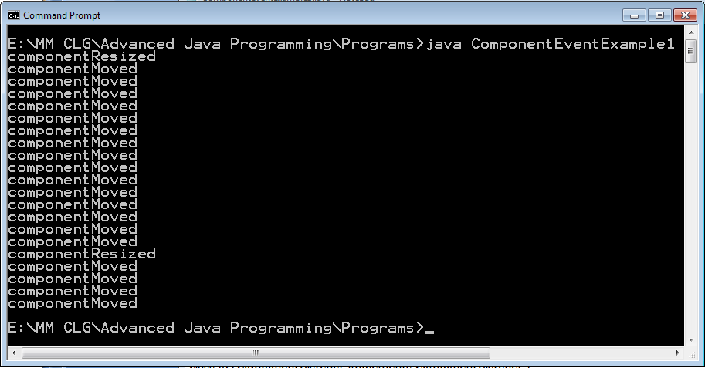
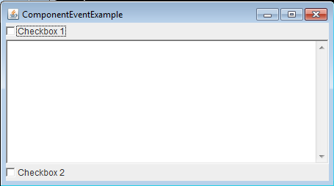
Output

Slide 36
ContainerEvent class
A low-level event which indicates that a container's contents changed because a component was added or removed
This class has following constants.
public static final int COMPONENT_ADDED
This event indicates that a component was added to the container.
public static final int COMPONENT_REMOVED
This event indicates that a component was removed from the container.
public ContainerEvent(Component source, int id, Component child)
Constructs a ContainerEvent object.
Parameters:
source - the Component object (container) that originated the event
id - an integer indicating the type of event
child - the component that was added or removed

Slide 37
Conti…
public Container getContainer()
Returns the originator of the event.
Returns the Container object that originated the event, or null if the object is not a Container.
public Component getChild()
Returns the component that was affected by the event.
Returns the Component object that was added or removed.
The listener interface for receiving container events.
void componentAdded(ContainerEvent e)
Invoked when a component has been added to the container.
void componentRemoved (ContainerEvent e)
Invoked when a component has been removed from the container.

Slide 38
Programming Example
import java.awt.*;
import java.awt.event.*;
import javax.swing.*;
public class ContainerEventExample
{
public static void main(String args[])
{
JFrame frame = new JFrame();
frame.setDefaultCloseOperation(JFrame.EXIT_ON_CLOSE);
Container contentPane = frame.getContentPane();
ContainerListener cont = new ContainerListener()
{
ActionListener listener = new ActionListener()
{
public void actionPerformed(ActionEvent e)
{
System.out.println("Selected: " + e.getActionCommand());
}
};

Slide 39
Conti…
public void componentAdded(ContainerEvent e)
{
Component c = e.getChild();
if (c instanceof JButton)
{
JButton b = (JButton) c;
b.addActionListener(listener);
}
}
public void componentRemoved(ContainerEvent e)
{
Component c = e.getChild();
if (c instanceof JButton)
{
JButton b = (JButton) c;
b.removeActionListener(listener);
}
}
};

Slide 40
Conti…
contentPane.addContainerListener(cont);
contentPane.setLayout(new GridLayout(3, 2));
contentPane.add(new JButton("First"));
contentPane.add(new JButton("Second"));
contentPane.add(new JButton("Third"));
contentPane.add(new JButton("Fourth"));
contentPane.add(new JButton("Fifth"));
frame.setSize(300, 200);
frame.show();
}
}

Slide 41
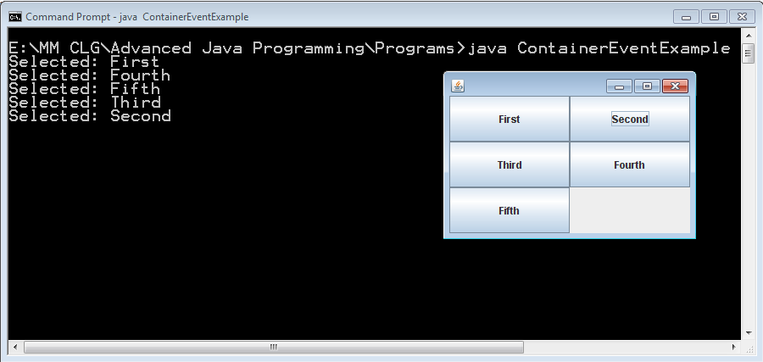
Output

Slide 42
FocusEvent class
A low-level event which indicates that a Component has gained or lost the input focus.
This class has following constants.
public static final int FOCUS_GAINED
This event indicates that the Component is now the focus owner.
public static final int FOCUS_LOST
This event indicates that the Component is no longer the focus owner.

Slide 43
Constructors
publicfocusEvent(Component source,int id,boolean temporary, Component opposite)
source - the Component that originated the event
id - FOCUS_GAINED or FOCUS_LOST
temporary - true if the focus change is temporary; false otherwise
opposite - the other Component involved in the focus change, or null
publicFocusEvent(Component source,int id,booleantemporary)
id - an integer indicating the type of event
temporary - true if the focus change is temporary; false otherwise.
public FocusEvent(Component source,int id)
source - the Component that originated the event
id - an integer indicating the type of event

Slide 44
FocusListener interface
void focusGained(FocusEvent e)
Invoked when a component gains the keyboard focus.
void focusLost(FocusEvent e)
Invoked when a component loses the keyboard focus.

Slide 45
Programming Example
import java.awt.*;
import java.awt.event.*;
import javax.swing.*;
public class FocusListenerExample extends JFrame implements FocusListener
{
Button b1,b2;
public FocusListenerExample()
{
b1=new Button ("First");
b2=new Button ("Second");
add(b1,BorderLayout.SOUTH);
add(b2,BorderLayout.NORTH);
b1.addFocusListener(this);
b2.addFocusListener(this);
setSize(200,200);
setDefaultCloseOperation(JFrame.EXIT_ON_CLOSE);
setVisible(true);
}

Slide 46
Conti…
public void focusGained(FocusEvent fe) //method of focuslistener
{
if(fe.getSource()==b1)
System.out.println(b1.getLabel()+"gained");
if(fe.getSource()==b2)
System.out.println(b2.getLabel()+"gained");
if(fe.isTemporary())
System.out.println("Temporary Focus");
}
public void focusLost(FocusEvent fe) //in focusevent "getID()"is a method
{
if(fe.getSource()==b1)
System.out.println(b1.getLabel()+"lost");
if(fe.getSource()==b2)
System.out.println(b2.getLabel()+"lost");
}
public static void main(String a[])
{
new FocusListenerExample();
}
}

Slide 47
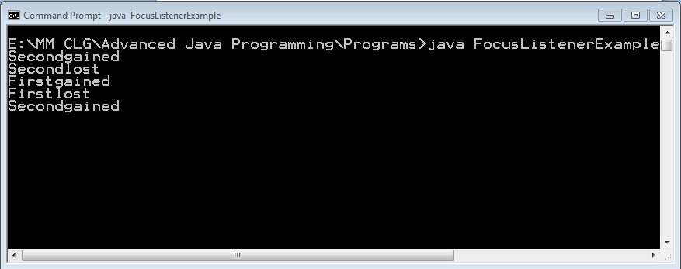
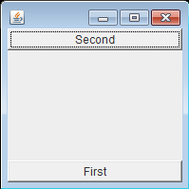
Output

Slide 48
ItemEvent class
A semantic event which indicates that an item was selected or deselected.
This high-level event is generated by an ItemSelectable object (such as a List) when an item is selected or deselected by the user.
This class has following constants.
public static final int SELECTED
This state-change value indicates that an item was selected.
public static final int DESELECTED
This state-change-value indicates that a selected item was deselected
public ItemEvent (ItemSelectable source, int id, Object item, int stateChange)
Constructs an ItemEvent object.
Parameters:
source - the ItemSelectable object that originated the event
id - an integer that identifies the event type
item - an object -- the item affected by the event
stateChange - an integer that indicates whether the item was selected or deselected

Slide 49
Methods of ItemEvent Class
public ItemSelectable getItemSelectable()
Returns the creator of the event.
Returns: the ItemSelectable object that originated the event.
public Object getItem()
Returns the item affected by the event.
Returns: the item (object) that was affected by the event.
public int getStateChange()
Returns the type of state change (selected or deselected).
Returns: an integer that indicates whether the item was selected or deselected

Slide 50
ItemListener interface
The listener interface for receiving item events.
void itemStateChanged(ItemEvent e)
Invoked when an item has been selected or deselected by the user.
The code written for this method performs the operations that need to occur when an item is selected (or deselected).

Slide 51
KeyEvent class
An event which indicates that a keystroke occurred in a component.
This class has following constant.
public static final int KEY_PRESSED
The "key pressed" event. This event is generated when a key is pushed down.
public static final int KEY_RELEASED
The "key released" event. This event is generated when a key is let up.
public static final int KEY_TYPED
The "key typed" event.
This event is generated when a character is entered. In the simplest case, it is produced by a single key press.
Often, however, characters are produced by series of key presses, and the mapping from key pressed events to key typed events may be many-to-one or many-to-many.

Slide 52
Methods of KeyEvent class
public int getKeyCode()
Returns the integer keyCode associated with the key in this event.
Returns: the integer code for an actual key on the keyboard.
public char getKeyChar()
Returns the character associated with the key in this event.
For example, the KEY_TYPED event for shift + "a" returns the value for "A".
boolean isActionKey()
Returns true if the key firing the event is an action key. Examples of action keys include Page Up, Caps Lock, the arrow and function keys.

Slide 53
KeyListener Interface
Key events indicate when the user is typing at the keyboard.
Key events are fired by the component with the keyboard focus when the user presses or releases keyboard keys.
Notifications are sent about two basic kinds of key events:
The typing of a Unicode character
The pressing or releasing of a key on the keyboard
The first kind of event is called a key-typed event.
To know when the user types a Unicode character ? whether by pressing one key such as 'a' or by pressing several keys in sequence ?
The second kind is either a key-pressed or key-released event.
To know when the user presses the F1 key, or whether the user pressed the '3' key on the number pad, you handle key-pressed events.

Slide 54
Methods of KeyListener Interface
Method | Purpose
keyTyped(KeyEvent) | Called just after the user types a Unicode character into the listened-to component.
keyPressed(KeyEvent) | Called just after the user presses a key while the listened-to component has the focus.
keyReleased(KeyEvent) | Called just after the user releases a key while the listened-to component has the focus.

Slide 55
TextEvent class
A semantic event which indicates that an object's text changed.
This high-level event is generated by an object (such as a TextComponent) when its text changes.
public TextEvent(Object source,int id)
Constructs a TextEvent object.
Parameters:
source - the (TextComponent) object that originated the event
id - an integer that identifies the event type

Slide 56
TextListener interface
The listener interface for receiving text events.
void textValueChanged(TextEvent e)
Invoked when the value of the text has changed.
The code written for this method performs the operations that need to occur when text changes.

Slide 57
WindowEvent class
A low-level event indicates that a window has changed its status.
This event is generated by a Window object when it is opened, closed, activated, deactivated, iconified, or deiconified, or when focus is transferred into or out of the Window.

Slide 58
int constants
WINDOW_ACTIVATED
WINDOW_CLOSED
WINDOW_CLOSING
WINDOW_DEACTIVATED
WINDOW_DEICONIFIED
WINDOW_GAINED_FOCUS
WINDOW_ICONIFIED
WINDOW_LOST_FOCUS
WINDOW_OPENED
WINDOW_STATE_CHANGED

Slide 59
Constructors
public WindowEvent(Window source,int id)
Constructs a WindowEvent object.
Parameters: source - the Window object that originated the event
id - an integer indicating the type of event
publicWindowEvent(Window source, int id, Window opposite, int oldState, int newState)
Note that passing in an invalid id results in unspecified behavior.
This method throws an IllegalArgumentException if source is null.
Parametrs:
source - the Window object that originated the event
id - an integer indicating the type of event.
opposite - the other window involved in the focus or activation change, or null
oldState - previous state of the window for window state change event
newState - new state of the window for window state change event

Slide 60
WindowListener interface
void windowClosing(WindowEvent e)
Invoked when the user attempts to close the window from the window's system menu.
void windowClosed(WindowEvent e)
Invoked when a window has been closed as the result of calling dispose on the window
void windowIconified(WindowEvent e)
Invoked when a window is changed from a normal to a minimized state.
void windowOpened(WindowEvent e)
Invoked the first time a window is made visible.
void windowDeiconified(WindowEvent e)
Invoked when a window is changed from a minimized to a normal state.
void windowActivated(WindowEvent e)
Invoked when the Window is set to be the active Window.
void windowDeactivated(WindowEvent e)
Invoked when a Window is no longer the active Window

Slide 61
WindowFocusListener interface
The listener interface for receiving WindowEvents, including WINDOW_GAINED_FOCUS and WINDOW_LOST_FOCUS events.
void windowGainedFocus(WindowEvent e)
Invoked when the Window is set to be the focused Window, which means that the Window, or one of its subcomponents, will receive keyboard events.
This event indicates a mouse action occurred in a component. This low-level event is generated by a component object for Mouse Events and Mouse motion events.

